Slide 1
Introduction to linguistics
Week 2: Speech and writing

Slide 2
Road map
International Phonetic Alphabet (IPA)
Speech organs
Consonants

Slide 3
IPA

Slide 4
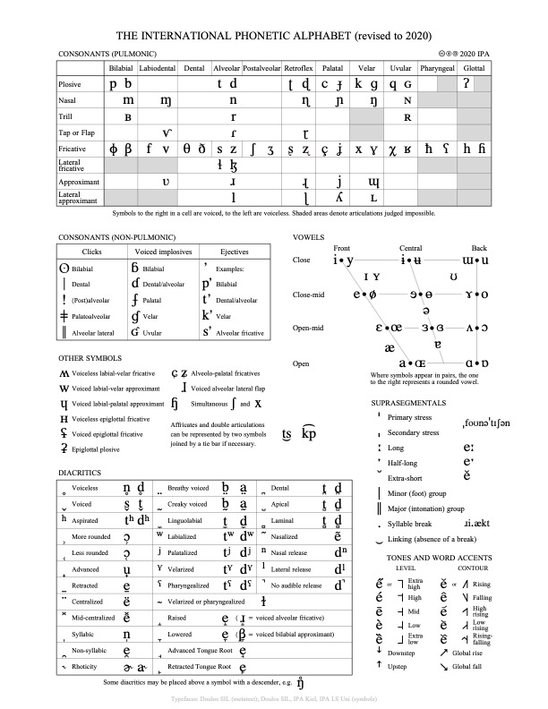
International Phonetic Association and
International Phonetic Alphabet (IPA)
International Phonetic Association is the major representative organisation for phoneticians
  Established in 1886 in Paris.
Its aim is to promote the scientific study of phonetics and the various practical applications of it
The IPA provides the academic community world-wide with a notational standard for the phonetic representation of all languages - the International Phonetic Alphabet (IPA)
https://www.internationalphoneticassociation.org/IPAcharts/IPA_chart_orig/pdfs/IPA_Kiel_2020_full.pdf [28 October 2020]

Slide 5
Transcribing sounds
transcription
phonetic
phonemic
/ rɪŋ /
/ tɪl /
narrow
broad
[ ɹɪ̃ŋ ]
[ t^{h}ɪ̃ɫ ]
[ ɹɪŋ ]
[ tɪɫ ]
Kortmann (2010: 61)

Slide 6
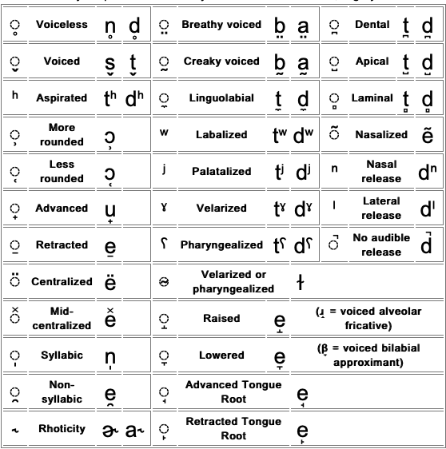
Diacritics in IPA
https://www.internationalphoneticassociation.org/IPAcharts/IPA_chart_orig/pdfs/IPA_Kiel_2020_full.pdf [28 October 2020]

Slide 7
Speech organs

Slide 8
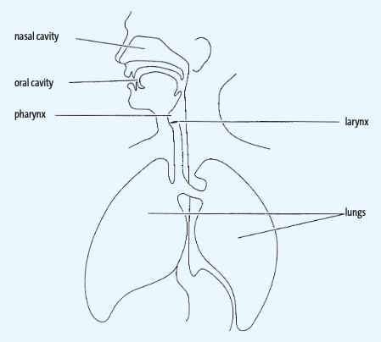
Physiological basis of speech
No primary speech organs in humans
  Speech only secondary function
Speech sounds consist of…
  Muscular activity
    Contraction & relaxation of the muscles
  Air movement
    Pulmonic, mostly egressive, i.e. out of the vocal tract
    Ingressive sounds very infrequent
  Cavities as resonation space
    Oral and nasal cavities
Bieswanger & Becker (2017: 41)

Slide 9
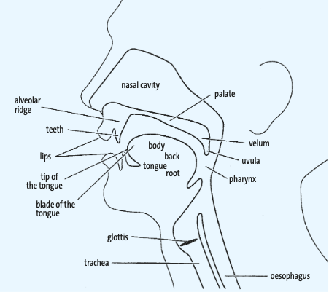
Speech organs: Vocal tract
Alveolar ridge
Hard palate
Soft palate (velum)
Uvula
Pharynx
Epiglottis
Larynx
Vocal cords/folds
Glottis
Trachea
Bieswanger & Becker (2017: 42)

Slide 10
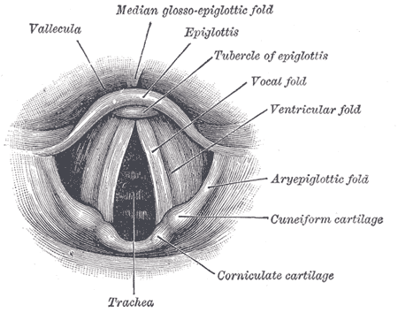

Speech organs: Vocal cords
Bieswanger & Becker (2017: 43)
https://commons.wikimedia.org/wiki/File:Gray956.png [28 October 2020]

Slide 11
How does speaking look like?
You wish to know all about my grandfather. Well, he is nearly 93 years old, yet he still thinks swiftly as ever. He dresses himself in an old black frock coat usually several buttons missing. A long beard clings to his chin, giving those who observe him a pronounced feeling of the utmost respect. When he speaks, his voice is just a bit cracked and quivers a bit. Twice each day he plays skilfully and with zest upon a small organ. Except in the winter when the snow or ice prevents, he slowly takes a short walk in the open air each day. We have often urged him to walk more and smoke less, but he always answers ‘Banana oil!’ Grandfather likes to be modern in his language.
https://sail.usc.edu/span/rtmri_ipa/je_2015.html [28 October 2020]

Slide 12
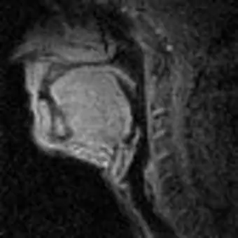
How does speaking look like?
You wish to know all about my grandfather. Well, he is nearly 93 years old, yet he still thinks swiftly as ever. He dresses himself in an old black frock coat usually several buttons missing. A long beard clings to his chin, giving those who observe him a pronounced feeling of the utmost respect. When he speaks, his voice is just a bit cracked and quivers a bit. Twice each day he plays skilfully and with zest upon a small organ. Except in the winter when the snow or ice prevents, he slowly takes a short walk in the open air each day. We have often urged him to walk more and smoke less, but he always answers ‘Banana oil!’ Grandfather likes to be modern in his language.
https://sail.usc.edu/span/rtmri_ipa/je_2015.html [28 October 2020]

Slide 13
consonants

Slide 14
Consonants vs. vowels
Every language has vowels, e.g. /a/, as well as consonants, e.g. /p/
These two sounds represent two bigger groups of sounds. What’s the difference between them?
  Consonants obstruction of the airflow
  Vowels no obstruction of the airflow

Slide 15
Consonants: Three questions
  Consonants are defined by an obstruction of the airflow. Every such obstruction can be described by answering the following three questions:
  Where does it happen? Place of articulation
  How does it happen? Manner of articulation
  What do the vocal cords do during the obstruction? Voicing

Slide 16
Consonants: Where?
/t/ /d/ /n/ /s/ /z/ /l/ /ɹ/
/ʃ/ /ʒ/ /tʃ/ /dʒ/
Lips, lips & teeth
  /p/, /b/, /m/, /w/ bilabial
  /f/, /v/ labiodental
Teeth
  /θ/, /ð/ interdental
Alveolar ridge
  /t/, /d/, /n/ alveolar
  /s/, /z/, /l/, /ɹ/
Palate/alveolar ridge
  /ʃ/, /ʒ/, /tʃ/, /dʒ/ post-alveolar
Hard palate
  /j/ palatal
Soft palate (velum)
  /k/, /g/, /ŋ/ velar
Glottis
  /h/, /ʔ/ glottal
/j/
/θ/ /ð/
/p/ /b/ /m/ /w/
  /k/ /g/ /ŋ/
/f/ /v/
/h/ /ʔ/

Slide 17
Consonants: How?
Knowing where is, however, not enough to identify a consonant. The following consonants are produced in the same place. How do they differ?
  /t/ /s/
  /b/ /m/
  /z/ /n/
They differ in their manner of articulation!

Slide 18
Consonants: How? II
Plosives/Stops /p/, /b/, /t/, /d/, /k/, /g/
Fricatives /f/, /v/, /ʃ/, /ʒ/, /s/, /z/, /θ/, /ð/, /h/
Affricates /tʃ/, /dʒ/
Nasals /m/, /n/, /ŋ/
Approximants /w/, /ɹ/, /j/, /l/
Affricates are homorganic plosives & fricatives
= ‘produced in the same place’

Slide 19
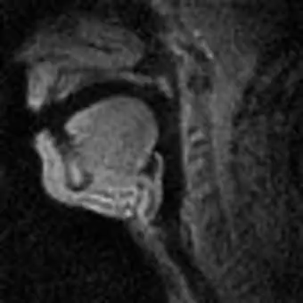
Plosives
Airstream blocked by a complete closure
https://sail.usc.edu/span/rtmri_ipa/je_2015.html [28 October 2020]

Slide 20
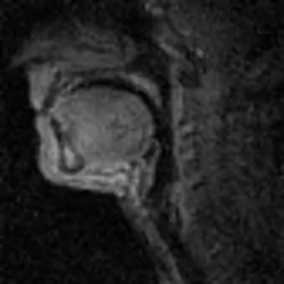
Fricatives
Narrow opening (almost closure) produces friction
https://sail.usc.edu/span/rtmri_ipa/je_2015.html [28 October 2020]

Slide 21
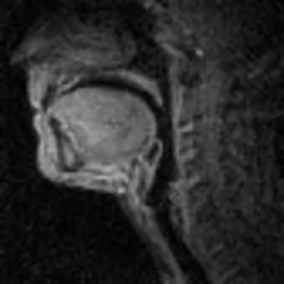
Affricates
Combination of a plosive & a fricative
https://sail.usc.edu/span/rtmri_ipa/je_2015.html [28 October 2020]

Slide 22
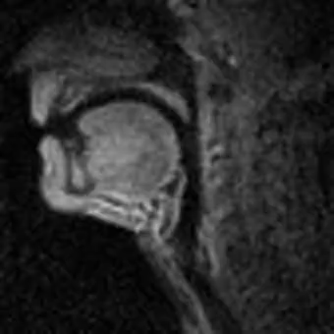
Nasals
Airstream passes through the nose
https://sail.usc.edu/span/rtmri_ipa/je_2015.html [28 October 2020]

Slide 23
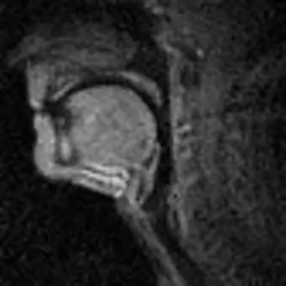
Approximants
Articulators close to each other, but not as close as in fricatives
https://sail.usc.edu/span/rtmri_ipa/je_2015.html [28 October 2020]

Slide 24
Voicing
Vibration of the vocal cords/folds
  In order to vibrate, the vocal cords have to be close enough
  Vowels are always voiced
  Some consonants, however, have voiced and voiceless variants
    [s] [z] sip zip
    [p] [b] pin bin
    [t] [d] ten den
    [f] [v] fan van
    [k] [g] coat goat
    [ʃ] [ʒ] Confucian confusion
    [tʃ] [dʒ] chin gin
    [θ] [ð] thin then
Bieswanger & Becker (2017: 43)

Slide 25
Nasality
Oral vs. nasal
Velum (soft palate) can close off (or not) the nasal cavity and thus produce oral (or nasal) sounds
  [m]
  [n]
  [ŋ]
Bieswanger & Becker (2017: 42)

Slide 26
Summary
Letters are not sounds
English consonant inventory
Features for describing consonants
  Place of articulation
  Manner of articulation
  Voicing
Bieswanger & Becker (2017: 42)

Slide 27
English (RP) consonants (IPA)
t͡ʃ d͡ʒ

Slide 28
English (RP) consonants (IPA)
Plag et al. (2009: 15)

Slide 29
Useful links
IPA
  www.internationalphoneticassociation.org/IPAcharts/IPA_chart_orig/pdfs/IPA_Kiel_2020_full.pdf
Type IPA phonetic symbols
  for English http://ipa.typeit.org/
  for all languages http://ipa.typeit.org/full/
Real-time MRI IPA
  https://sail.usc.edu/span/rtmri_ipa/index.html
Consonant visualisation
  http://www.yorku.ca/earmstro/ipa/consonants.html

Slide 30
Thank you!

Slide 31
List of references
Bieswanger, Markus & Annette Becker. 2017. Introduction to English Linguistics. 4th revised ed. Tübingen: Narr Francke Attempto.
Finegan, Edward. 2004. Language. Its structure and use. 4th ed. Boston, MA: Wadsworth.
Kortmann, Bern. 2010. Linguistics: Essential. Berlin: Cornelsen.
Plag, Ingo, Maria Braun, Sabine Lappe & Marelie Schramm. 2009. Introduction to Linguistics. 2nd ed. Berlin: De Gruyter Mouton.

