Slide 1
Introduction to linguistics
Week 2: Speech and writing

Slide 2
Vowels

Slide 3
Consonants & vowels
How do we define consonants & vowels?
Consonants obstruction of airflow
Stops/Plosives complete blockage followed by release (explosion)
Fricatives incomplete blockage, articulators approach each other closely
Nasals complete blockage with release through nasal cavity
Affricates two articulations in the same place
Approximants incomplete blockage, articulators stay further apart than in fricatives
Liquids type of approximants, in English [l] & [r]
Glides type of approximants, in English [j] & [w], also called semi-vowels
Vowels modulation rather than obstruction of airflow

Slide 4
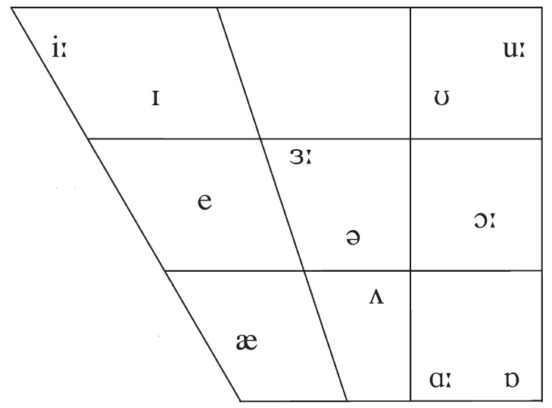
English vowels: Quality
Height of the tongue
high < > low
Part of the tongue
front < > back

Slide 5
English vowels II: Roundedness
If we know, how high/low and how fronted a vowel is, the next important question is: What do the lips do?

Slide 6
English vowels III: Quantity
[u] vs [u:]

Slide 7
English vowels in rtMRI
Front high unrounded /i/
https://sail.usc.edu/span/rtmri_ipa/je_2015.html [28 October 2020]

Slide 8
English vowels in rtMRI II
Central mid /ə/
https://sail.usc.edu/span/rtmri_ipa/je_2015.html [28 October 2020]

Slide 9
English vowels in rtMRI III
Back high rounded /u/
https://sail.usc.edu/span/rtmri_ipa/je_2015.html [28 October 2020]

Slide 10
English vowels: Overview
Quantity (Length of the vowel)
Long (tense)
Short (lax)
Quality
Position of the tongue on the y axis
High (close)
Mid
Low (open)
Position of the tongue on the x axis
Front
Central
Back
Roundedness
Only /ɔː/, /uː/ and /ʊ/ affected in English
No rounded/unrounded vowel pairs in PDE

Slide 11
Monophthongs vs diphthong
English vowels
Monophthongs
Vowel quality (i.e. position & height of the tongue) remains constant during the production of the vowel
Diphthongs
Vowel quality (i.e. position & height of the tongue) changes during the production of the vowel

Slide 12
English diphthongs: Overview
Diphthongs ending in /ɪ/
/eɪ/ day
/aɪ/ buy
/ɔɪ/ boy
Diphthongs ending in /ʊ/
/əʊ/ boat
/aʊ/ how
Diphthongs ending in /ə/
/ɪə/ here
/ɛə/ there
/ʊə/ tour
Closing diphthongs
Centring diphthong (only RP)
Bieswanger & Becker (2017: 57)

Slide 13
English monophthong & diphthongs: Overview
Part of the tongue
front < > back
Height of the tongue
high < > low
Monophthongs & diphthongs in the word b_t

Slide 14
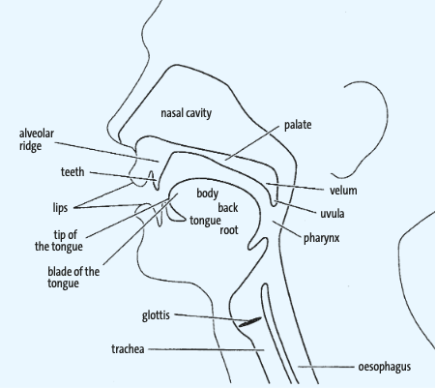
Phonetics: Summary
Consonantal features
Place of articulation
Manner of articulation
Voicing
Where?
Labial, alveolar, post-alveolar, palatal, velar, glottal
How?
Plosives, fricative, nasals, affricates, approximants
What do the vocal cords do?
Voiced, voiceless
Bieswanger & Becker (2017: 42)

Slide 15
Phonetics: Summary II
What is the difference between consonants and vowels?
Obstruction of airstream
How do we describe monophthongs?
Quantity long vs. short
Quality high vs. low / close vs. open front vs. back rounded vs. unrounded
How do we categorize diphthongs?
Closing vs. centring
Bieswanger & Becker (2017: 57)

Slide 16
Useful links
IPA
www.internationalphoneticassociation.org/IPAcharts/IPA_chart_orig/pdfs/IPA_Kiel_2020_full.pdf
Type IPA phonetic symbols
for English http://ipa.typeit.org/
for all languages http://ipa.typeit.org/full/
Real-time MRI IPA
https://sail.usc.edu/span/rtmri_ipa/index.html
Consonant visualisation
http://www.yorku.ca/earmstro/ipa/consonants.html

Slide 17
Thank you!

Slide 18
List of references
Bieswanger, Markus & Annette Becker. 2017. Introduction to English Linguistics. 4th revised ed. Tübingen: Narr Francke Attempto.
Finegan, Edward. 2004. Language. Its structure and use. 4th ed. Boston, MA: Wadsworth.
Kortmann, Bern. 2010. Linguistics: Essential. Berlin: Cornelsen.
Plag, Ingo, Maria Braun, Sabine Lappe & Marelie Schramm. 2009. Introduction to Linguistics. 2nd ed. Berlin: De Gruyter Mouton.

