Slide 1
Session 6 – Introduction to Linguistics
Shuk Han (Sara) HO 08/12/2020

Slide 2
Types of Morpheme
Noun : Student
Verb: Sing
Adjective: new
Adverb quickly
Open (lexical)
Free
Preposition: from
Article: an
Conjunction: but
Close (grammatical)
un-, dis-, -er, -ment
Create new lexemes
Derivational affix (lexical)
Bound
-ing, -s, -ed
Inflectional affix (grammatical)
Create new word forms

Slide 3
Types of Morpheme
Derivational affix (lexical): - ment, un- , dis-
Create new lexemes/new dictionary entry
Bound
Inflectional affix (grammatical): -s, -ed, -´s
Create new word forms
Prefix : dis-, bi-, un-
English
All prefixes in English are derivational
Affix
Suffix: -ment, -ism, -s
Infix: absobloominglutely
Circumfix: German past participle ge- -t

Slide 4
HOmework
Segment the following English words into morphemes. Decide for each one whether it is free or bound. Where applicable, decide what kind of affix is involved and whether it is inflectional or derivational.
lever {lever}, free
greater {great} free, {-er} inflectional suffix
hamburger {ham} free, {burger} free // {hamburg} free, {-er} derivational suffix
thickeners {thick} free, {-en} derivational suffix, {-er} derivational suffix, {-s} inflectional suffix
environmental {environ} free, {-ment} derivational suffix// {environment} free, {-al} derivational suffix
antidisestablishmentarianism {anti-} derivational prefix, {dis-} derivational prefix, {establish} free, {-ment} derivational suffix, {-arian} derivational suffix, {-ism} derivational suffix

Slide 5
HOmework
Compare with the help of a dictionary: handbag, egghead, catfish, redeye
Are these words endocentric or exocentric compounds?
Hand bag – endocentric
Egg head – exocentric
Cat fish – endocentric
Red eye – exocentric // endocentric

Slide 6
HOmework
3. By means of which word-formation processes have the following lexemes been arrived at?
(When two or more word-formation processes are involved, specify their order.)
I. Lockdown 1. compound (lock + down verb) 2.conversion
II. language lab clipping
III. infotainment blends: information + entertainment
IV. laser acronyms
V. RCEP alphabetisms
VI. Stupipedia blend: stupid + Wikipedia
VII. Kangaroo borrowing from Austrian aboriginal language

Slide 7
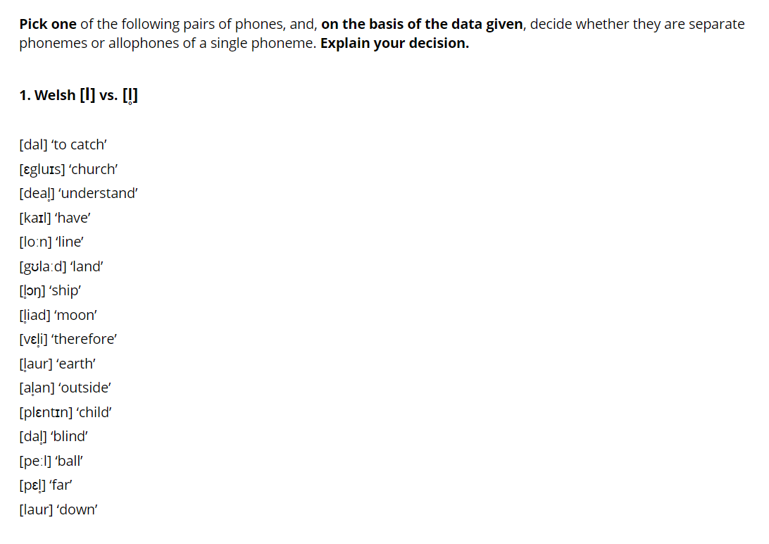
Weekly Quiz iV
differ in one sound
Minimal pairs
Phonemes
have distinct meanings

Slide 8
Weekly Quiz iV
differ in one sound
Minimal pairs
have distinct meanings
Allophones

Slide 9
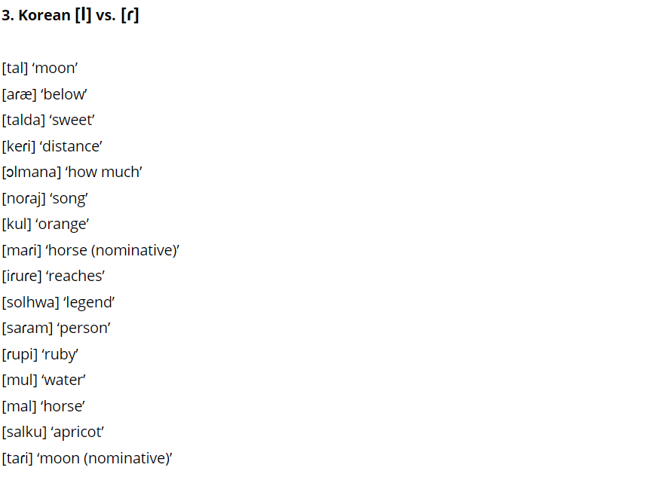
Weekly Quiz iV
differ in one sound
Minimal pairs
have distinct meanings
Allophones

Slide 10
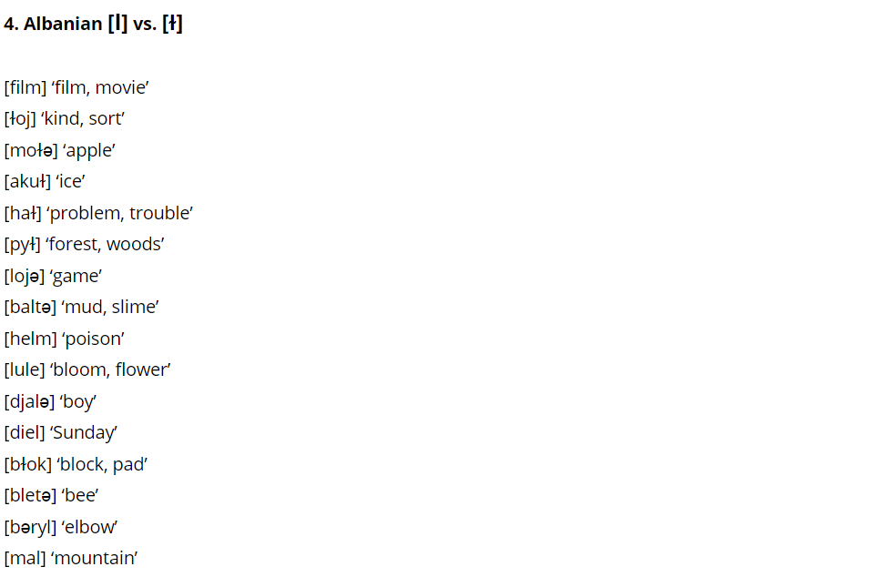
Weekly Quiz iV
differ in one sound
Minimal pairs
have distinct meanings
Allophones

Slide 11
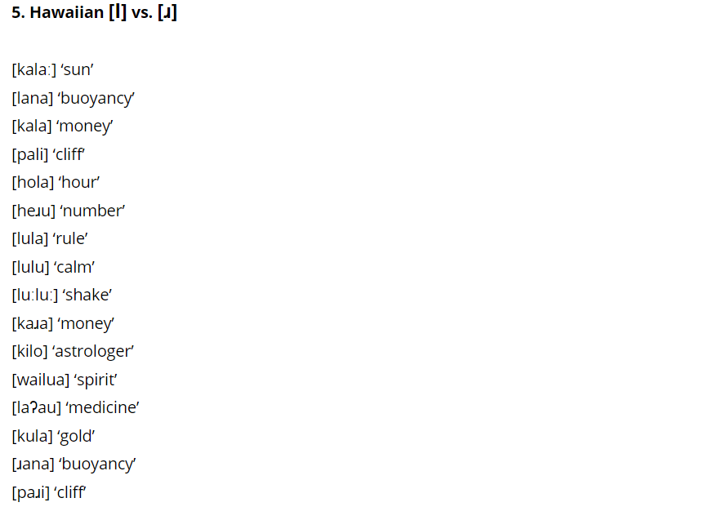
Weekly Quiz iV
differ in one sound
Minimal pairs
have distinct meanings
Allophones

Slide 12
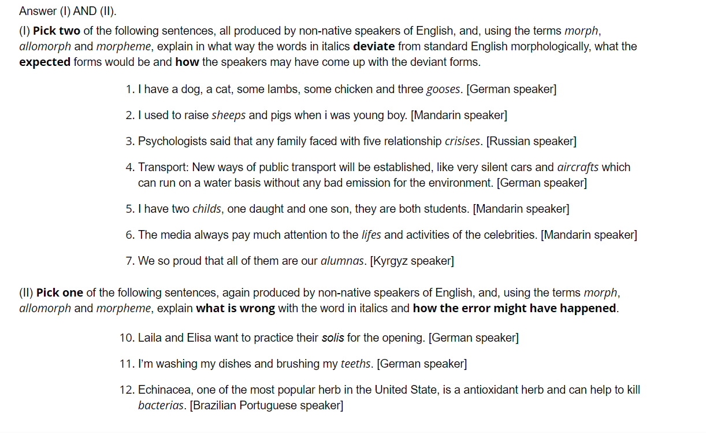
Weekly quiz V

Slide 13
Morpheme & Allomorph
Phonology: Phoneme /t/, /l/, /dʒ/ , Phone [l], [ɫ], [ʔ]
[l] & [ɫ] are allophone of the phoneme /l/
Morpheme: {-s} plural marker, {electric} adj
Morph: {-s} /-z/ /-s/ /-iz/ as in kid-s kit-s kiss-es;
{electric} /ɪlektrɪk/, electric-ity /ɪlektrɪs/ /ɪti/, electric-ian /ɪlektrɪʃ/ /ən/
Allomorph: /-z/ /-s/ /-iz/ are allomorphs of the morpheme {-s} plural marker
/ɪlektrɪk/, /ɪlektrɪs/, /ɪlektrɪʃ/ are allomorphs of the morpheme {electric}

