Slide 1
Session 7 – Introduction to Linguistics
Shuk Han (Sara) HO 015/12/2020

Slide 2
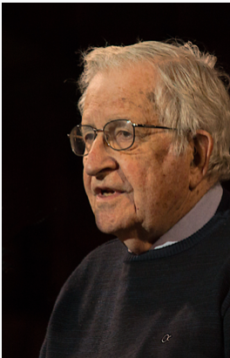
Syntax
Generative linguistics
Noam Chomsky (1928 –
Transformational Grammar, Minimalist Program, Universal Grammar

Slide 3
Type of Phrase
Term | Head | Examples
Noun Phrase (NP) | Noun | Mary, she, the boy, the man with the glasses, the girl who stood at the corner
Verb Phrase (VP) | Verb | has/was asked, may ask, is asking, may have been asked
Adjective Phrase (AdjP) | Adjective | old, young, ambitious
Adverb Phrase (AdvP) | Adverb | very quickly, right here
Preposition Phrase (PP) | Preposition | At work, in the garden on the roof, after the match has finished

Slide 4
Homework
Consider the phrases in bold. Identify their phrase type. Label each word in the phrase for its word class and specify the head.
I. John called me an idiot.
II. It’s never too early to think about the future.
III. He spends all his money on horses.
IV. This task is ridiculously difficult for us.
VP called – verb. Head. me – noun/pronoun. an- article/determiner. idiot- noun
AdjP too – adverb. early – adjective Head
NP all – determiner/quantifier. His – determiner/possessive. money – noun Head
AdjP ridiculously – adverb. difficult – adjective Head. for – preposition. us – noun/pronoun

Slide 5
HOmework
2. Which of the following is the preferred analysis for the sentence? Explain your answer using one of the constituency tests.
a. [They NP] [trusted VP] [in a friend. PP]
b. [They NP] [trusted in VP] [a friend. NP]
Movement Test In God we trust / God we trust in ?
Substitution Test [They] [trusted] [in some strangers]/ [They] [trusted in] [some strangers]
Deletion Test They trusted / They trusted in (transitive verb)
Constituent Test In whom they trusted/ who they trusted in

Slide 6
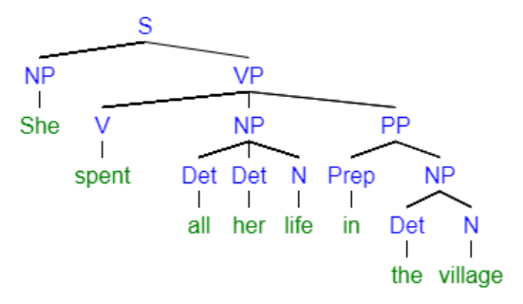
HOmework
3. Advanced question: Draw your own tree diagram of the following sentence:
She spent all her life in the village.

Slide 7
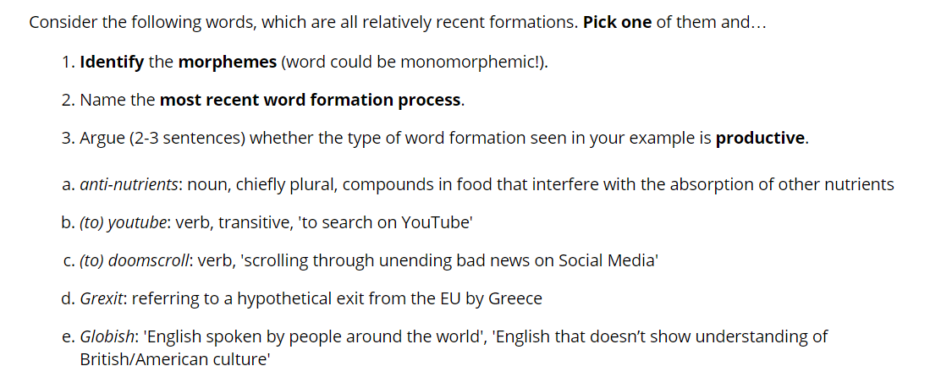
Weekly Quiz VI

