Slide 1
Session 10 – Introduction to Linguistics
Shuk Han (Sara) HO 19/01/2021

Slide 2
Test 9
My landlord has finally sent someone to at least repair the doorbell.
Which two of the following sentences are NOT entailed by the sentence in 1)?
a. It was my landlord who has sent someone to repair the doorbell.
b. It took my landlord many days to send someone to repair the doorbell.
c. My dishwasher needs repairing as well.
d. The doorbell is what is to be repaired by the person my landlord has sent.

Slide 3
Test 9
Everyone in the royal family loved our king's dog, who disappeared under mysterious circumstances.
Which two of the following sentences are NOT presuppositions of 2)?
a. The king had a dog.
b. There was at least one person in the royal family except for the king.
c. Our king's dog was loved by everyone in the royal family.
d. The king's dog has vanished.

Slide 4
Test 9
Which two of the following statements are incorrect?
a. The first constituent in a clause always carries special focus.
b. The first constituent in a sentence tends to be reserved for information that is new in the active discourse.
c. Cleft constructions are typically used to move a particular constituent into focus.
d. A passive can be used to mark the semantic patient of an event as topic.

Slide 5
Sense relation

Slide 6
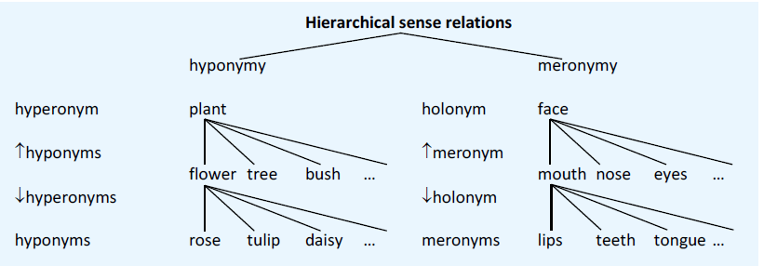
Sense relation I
Hypernym <-> Hyponym : Flower <-> Rose
Meronym <-> Holonym: Face <-> Mouth

Slide 7
Sense relation II – non-hierarchical
Label | Example
Synonym | Buy, Purchase
Complementary antonym | Male <-> Female
Gradable antonym | Hot <-> Cold
Relational opposite | Pupil <-> Teacher
Directional opposite | Push <-> Pull

Slide 8
Sense relation III – lexical ambiquity
Label | Example
Polysemy | Head “Top part of the body”/ “Person in charge”
Homonym I - Homophone | See <-> Sea
Homonym II – Homograph I | Lie “place oneself in a horizontal position” <-> Lie “Speak untruthfully”
Homonym II – Homograph II (Heteronym) | Bass “Instrument” <-> Bass “fish”

Slide 9
HOmework
1. Shortly explain and provide an example for the following terms:
i. Polysemy
ii. Homophone
iii. Homograph
iv. Heteronym

Slide 10
HOmework
2. What are the lexical relations between the words in the following pairs?
v. shallow – deep
vi. choose – select
vii. semantic – linguistics
viii. tree – leaf
ix. after – before
gradable antonyms
synonyms
hyponym - hypernym
holonym - meronym
complementary antonyms

Slide 11
homework
3. What is funny about the headline:
Where´s the party?
How to get young people to vote for their politicians.
Party is a polysemous

Slide 12
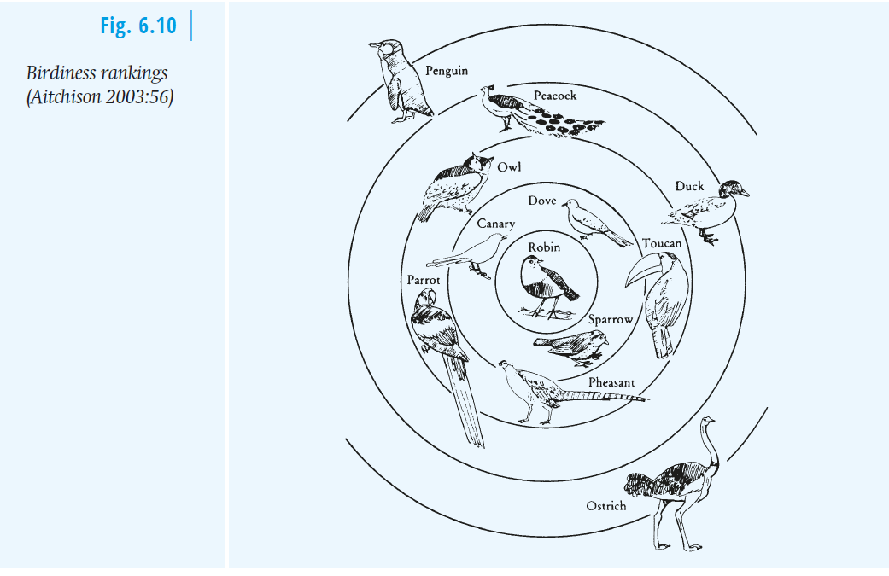
homework
Give an example of a prototypical member and a peripheral (opposite to prototypical) member of the concept animal.
Prototypical: dog, bird
Peripheral: human, plankton

