Slide 1
Session 8 – Introduction to Linguistics
Shuk Han (Sara) HO 05/01/2021

Slide 2
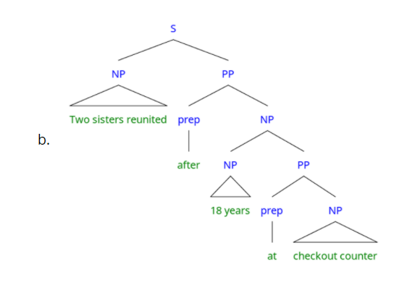
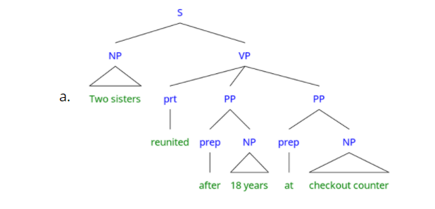
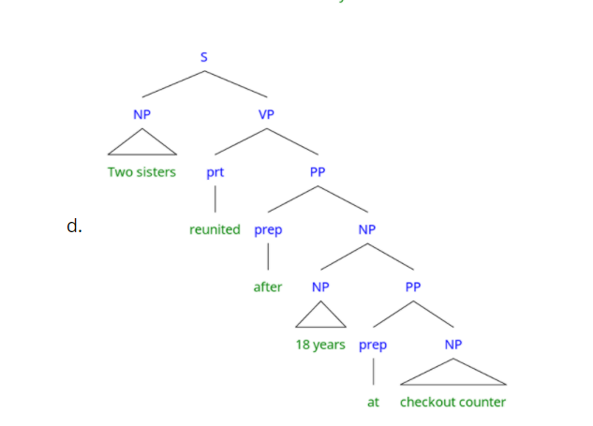
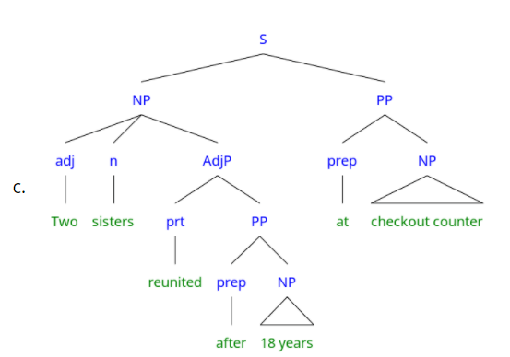
Test 7

Slide 3
Test 7
[PP after 18 years] [PP at check out counter]
[PP after [18 years at check out counter]]
The headline is ambiguous because we do not know how many adjunct adverbials there are.
The headline is ambiguous because we do not know whether the second PP is part of the first or not.
Two sisters reunited after 18 years at checkout counter!
This newspaper headline is involuntarily funny because it is structurally ambiguous.

Slide 4
Terminologies Clarification
Clause: a unit of speech that has a main verb.
Simple sentence = 1 Clause; Complex Sentence > 1 Clauses
SS: I am eating an apple. // A haze of greenish smoke was hovering over the scene.
CS: I am eating an apple while John is watching TV. // She thought that he believed that she had lied.
Syntactic form / Phrase Type: NP, VP, PP, AdjP
Syntactic Function: Subject, Object, Complement, Adjunct
Semantic Function/Role: Agent, Recipient, Theme

Slide 5
homework
What is the difference between complements (i.e., arguments) and adjuncts? Are the following phrases complement or adjunct?
Complements: Necessary to the clause, without complements the clause is incomplete
Adjuncts : Can be omitted without having an incomplete clause
My father is a teacher.
Tom hit Jerry.
We left as soon as we have finished breakfast.
Little James seemed very happy.
He was sitting on the table.
Complement
Complement
Adjunct
Complement
Adjunct

Slide 6
Homework
2. Identify the semantic roles (AGENT, PATIENT, THEME, INSTRUMENT, RECIPIENT, EXPERIENCER, MANNER, PLACE, TIME) of the following phrases:
vi. Jack ate the beans.
vii. Jerry was hit by Tom.
viii. The picture hangs above the fireplace.
ix. He brought me a car.
x. I received some money from my mum.
xi. John saw a movie last night.
PATIENT
AGENT
PLACE
RECIPENT
THEME
EXPERIENCER

Slide 7
complementation pattern/ Argument structure
Intransitive: Take only one argument//complement, i.e. subject
e.g. sleep, walk, dance
Transitive: Take two arguments//complements, i.e. subject & object
e.g. eat, drink, have
Di-transitive: Take three arguments//complements, i.e. subject & two objects
e.g. give, make, pay
(Complex-transitive: take more than three arguments, e.g. bet)

Slide 8
HOMEWORK
As mentioned in the reading, most verb can be used in more than one complementary patterns/argument structures. Try to analyse the complementary patterns of these sentence with the verb dance.
e.g. They danced a waltz. DANCE < Agent, Theme>
xii. They danced. DANCE <Agent> // DANCE <dancer>
xiii. They danced the judge a waltz. DANCE <Agent, Recipient, Theme> // DANCE <dancer, audience, dance>
xiv. They danced across the room. DANCE <Agent, (Place)> // DANCE < dancer, (location)>

Slide 9
Homework
Segment the following sentence into constituents. For each constituent, give, (a) the phrase type, (b) the syntactic function and (c) the semantic function.
She sneezed the foam off the cappuccino.
 | She | sneezed | the foam | off the cappuccino
a) Phrase type | NP | VP | NP | PP
b) Syntactic Function | Subject | Verb | Object | Complement
c) Semantic Function | EXPERIENCER |  | THEME/PATIENT | PLACE

