Slide 1
Session 9 – Introduction to Linguistics
Shuk Han (Sara) HO 12/01/2021

Slide 2
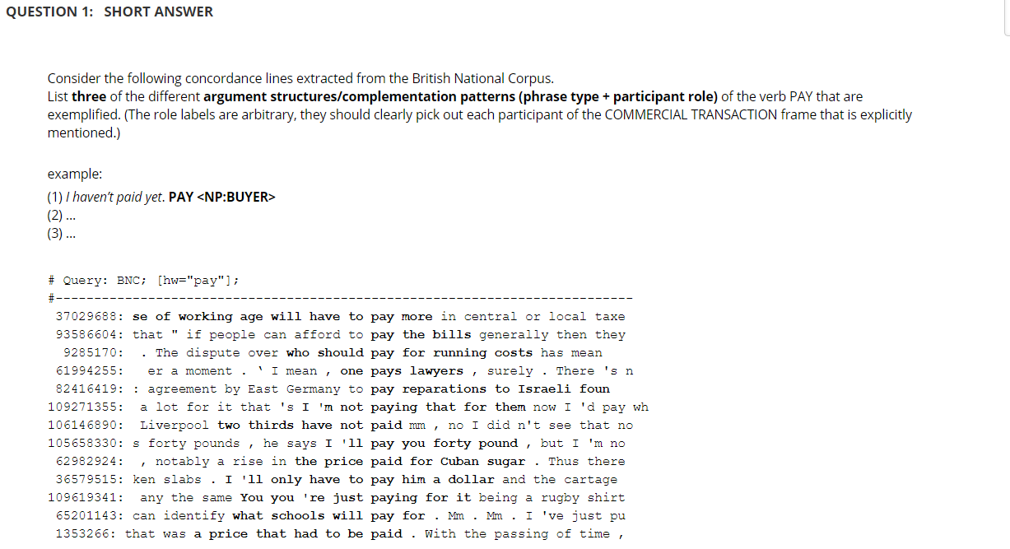
Test 8

Slide 3
Meaning
Semantic Theories:
Formal semantics
Conceptual semantics
Cognitive semantics
Lexical semantics
Etc…
Truth conditions Philosophy of language and philosophical logic

Slide 4
Sense and reference
Morning star & Evening star
Same reference, different sense
The president of the united states
Same sense, different reference
Sherlock Holmes, Unicorn
No reference
Willy Brandt
No sense (?)

Slide 5
Truth conditions
Merely concerning declarative sentences
E.g. I have two wugs in my kitchen. Truth / False
Originated from logic : p, q, ¬p, p^q

Slide 6
Entailment
A truth relation between sentences
Entailment defined by truth:
A sentence p entails a sentence q when the truth of the first (p) guarantees the truth of the second (q), and the falsity of the second (q) guarantees the falsity of the first (p)
If p is true, then q is true
If q is false, then p is false
p |  | q
T | → | T
F | ← | F

Slide 7
homework
1. Decide whether the following sentence a entails its b partner
Set 1
a. Olivia passed her driving test.
b. Olivia didn’t fail her driving test.
Set 2
a. Not everyone will like the show.
b. Someone will like the show.
Set 3
a. Arnold poisoned his wife.
b. Arnold killed his wife.
Set 4
a. I bought an animal today.
b. I bought a dog today.
Not
Entailment
Entailment
Not
Entailment
Not
Entailment

Slide 8
Presupposition
It is also a truth relation between sentences
Presupposition defined by truth:
A sentence p presuppose a sentence q when p is true, then q is true; and if p is false, then q is still true.
p |  | q
T | → | T
F | → | T

Slide 9
HOmework
2. What are the presuppositions of the following sentences?
Some books written by Chomsky are not very expensive.
Chomsky has written some books; some of his books are expensive
The present pope is German.
There were other popes; There is a pope
Even John couldn’t get tickets.
Someone else couldn't get the tickets
The King is France is bald.
There is a king of France

Slide 10
HOmework
What are the limits of the Principle of Compositionality?
Idioms, context, presuppositions cannot be analysed

Slide 11
Semantic beyond Truth condition
Sentence types: Declarative sentence, Imperative sentence, Interrogative sentence etc…
Sentence structure: passive structure, cleft structure ( It is John who passed him the sugar), topicalization
Contextual meaning (Pragmatics)

