Slide 1
Session 12 – Introduction to Linguistics
Shuk Han (Sara) HO 02/02/2021

Slide 2
Test 11
What do we call the type of indirect speech act that the instructor intends his question to be?
Explain what went wrong in the conversation. You will need to refer to direct and indirect speech acts.
Which conversational maxim does Wally flout? Explain your answer!

Slide 3
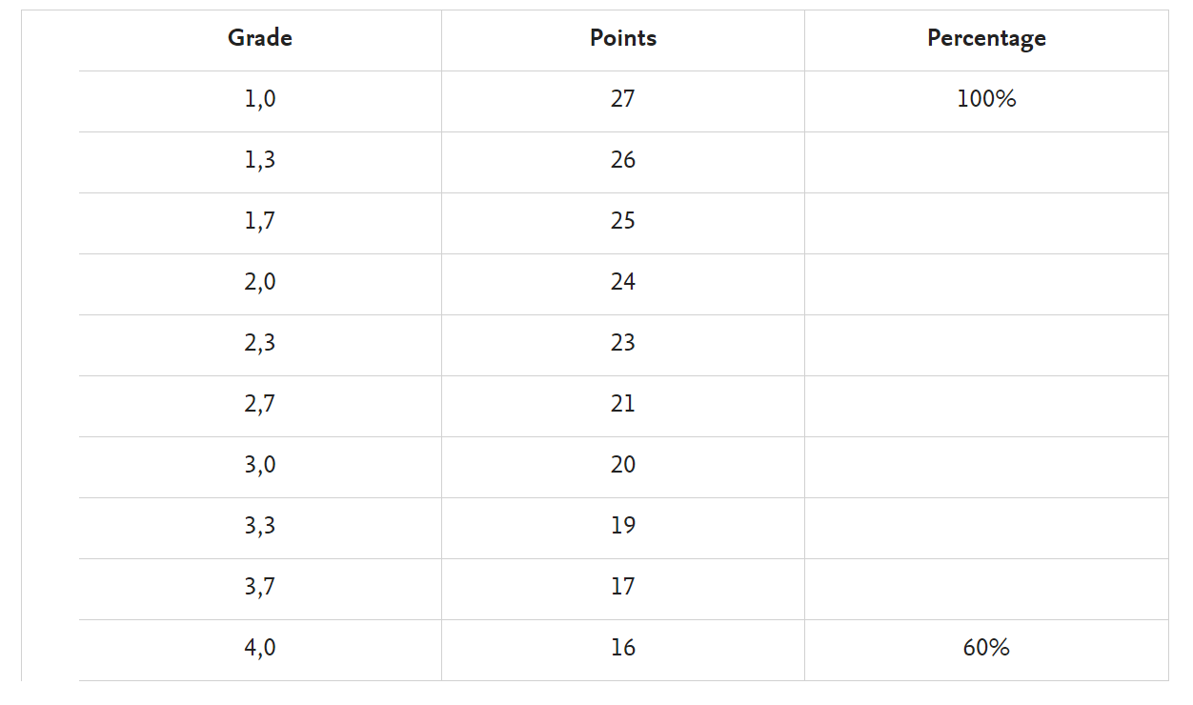
Organisation
11 tests (3 points each) – 2 worst result = Points
The best 9 results

Slide 4
Second attempt of exam
19th March 2021 – 21st March 2021 : 11 quizzes in four days

Slide 5
Next week
Introduction to seminars (Aufbau-seminar) of next semester
Join other seminars if you have time ☺
Preparation for next semester – Library Project

Slide 6
Text Linguistics
What makes a Text a Text?
A brunch of sentences grouping together is not a text.
Coherence – The sentences are sensically and logically related to each other
Cohesion - Tools help to establish Coherence: Adverbs, Conjunctions, Pronouns, Definite articles, Ellipsis, etc…

Slide 7
homework
1. What is “wrong” with the following passage? Use the term coherence to answer the question.
They did not want to stay poor all their lives. They won some money. Because of this, they were able to go on a holiday. Therefore, they had to spend two weeks in hospital. On this holiday, John and Mary went mountain-climbing. John and Mary did not enjoy the holiday. However, they were careless. John and Mary were poor. Thus they had an accident. So they bought a lottery ticket. Now they were poor again
Lack of coherence. Sentences are not connected in logical way

Slide 8
homework
2. Rewrite the passage in a sensical way. Identify the cohesive devices in the passage.
John and Mary were poor. They did not want to stay poor all their lives. So they bought a lottery ticket. They won some money. Because of this, they were able to go on a holiday. On this holiday, John and Mary went mountain-climbing. However, they were careless. Thus they had an accident. Therefore, they had to spend two weeks in hospital. John and Mary did not enjoy the holiday. Now they were poor again.

Slide 9
homework
2. Rewrite the passage in a sensical way. Identify the cohesive devices in the passage.
John and Mary were poor. They did not want to stay poor all their lives. So they bought a lottery ticket. They won some money. Because of this, they were able to go on a holiday. On this holiday, John and Mary went mountain-climbing. However, they were careless…. Thus they had an accident. Therefore, they had to spend two weeks in hospital. John and Mary did not enjoy the holiday. Now they were poor again.

Slide 10
Text Linguistics
Genre: Recipe, novel, public speech, textbook - Each genre has certain features that the texts fulfill
Register: a factor characterizing a given genre. Dimension of formatlity
Medium: Written/ Spoken

Slide 11
homework
3. Examine the following text extracts. Identify the Genre, Register and Medium associated with each text:
The mummified body of a 5,300-year-man discovered in the Dolomites on the Austro-Italian border completed a controversial journey yesterday to an Italian museum....
Genre: newspaper/journal article, Register: formal, Medium: written
I stand here today humbled by the task before us, grateful for the trust you have bestowed, mindful of the sacrifices borne by our ancestors.
Genre: public speech, Register: formal, Medium: spoken

Slide 12
homework
Staring at these four blank stainless-steel walls, I recalled one of Houdini’s great escapes I’d seen in a movie. He’s tied up in how many ropes and chains, stuffed into a big trunk, which is wound fast with another thick chain and sent hurtling, the whole lot, over Niagara Falls. Or maybe it was an icy dip in the Arctic Ocean. Given that I wasn’t all tied up, I was doing okay; insofar as I wasn’t clued in on the trick, Houdini was one up on me.
<Hard-Boiled Wonderland and the End of the World, Haruki Murakami>
Genre: novel, Register: informal, Medium: written
When day comes, we step out of the shade
aflame and unafraid
The new dawn blooms as we free it.
For there was always light.
If only we're brave enough to see it.
If only we're brave enough to be it.
<The Hill We Climb, Amanda Gorman>
Genre: poetry, Register: formal, Medium: written

